Slide 1
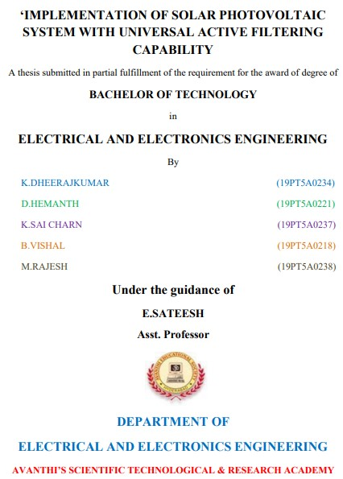
A SEMINAR REPORT ON

Slide 2
ABSTRACT
A technique based on second order sequence filter and proportional resonant controller is proposed for control of universal active power filter integrated with PV array (UAPF-PV). Using a second order sequence filter and sampling it at zero crossing instant of the load voltage, the active component of distorted load current is estimated, which is used to generate reference signal for shunt active filter. The proposed method has good accuracy in extracting fundamental active component of distorted and unbalanced load currents with reduced mathematical computations. Along with power quality improvement, the system also generates clean energy through the PV array system integrated to its DC-link. The UAPF-PV integrates benefits of power quality improvement and distributed generation. The system performance is experimentally evaluated on a prototype in the laboratory under a variety of disturbance conditions such as PCC voltage fall/rise, load unbalancing and variation in solar irradiation.

Slide 3
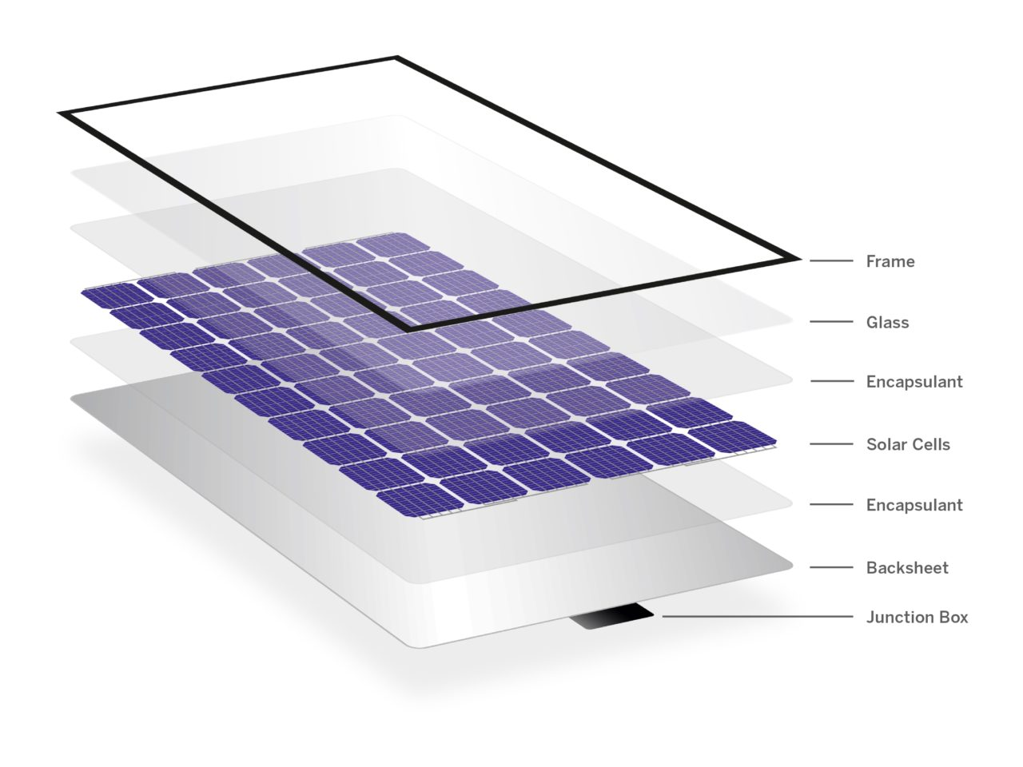
Contents
υ
Introduction
υ
Block Diagram
υ
Block Components
υ
Block’s Description
υ
Circuit Diagram
υ
Circuit Description
υ
Results
υ
Referances

Slide 4
Introduction
Now A Days The Usage of The renewable energy source (wind & solar PV) with the grid is increased
This is due to the development of reliable & efficient power converters, improved efficiency of PV panels, and decreasing cost of manufacturing
However, with the increasing penetration of renewable energy sources, which are intermittent sources of energy, fluctuations in voltage at the point of common coupling (PCC), have also increased.
This is particularly common in low voltage distribution systems. Another major issue faced in modern distribution systems is the extensive use of nonlinear power electronic systems, which draw highly distorted currents
Hence, the major requirement of the modern distribution system is the integration of renewable energy systems along with power quality improvement.

Slide 5
Block Diagram
RIPPLE
FILTER
COMPENSATOR
3
UNBALANCED
LOAD
AC
SERIES
INDUCTOR
SERIES
INDUCTANCE
BOOST
CONVERTER
SERIES VSC
SHUNT VSC
PV
ARRAY

Slide 6
Block Components
The Components that are used in this project are
3ph AC Source
3ph Balanced & Unbalanced Loads
PV Array
Boost Converter
Series VSC & Shunt VSC (voltage source converter)
Inductors
Series Transformers

Slide 7
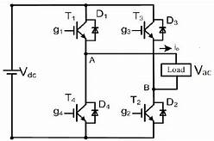
Block’s Description
VSC (Voltage Source Converter)
VSC Are the self commutated converter connected to HVAC & HVDC systems using devices suitable for high power applications (IGBT)
VSC is capable of able to generate AC without the need to rely on the AC system because they are self commutated this allows independent rapid control of both active & reactive power & black start capability
VSCs maintain a constant polarity of the DC voltage for their building blocks, such as the 2-level or 3-level converter as well as the so-called ‘modules’
The change of power flow direction is achieved by reversing the direction of the current.
Series VSC is used to inject variable voltage into the bus
Shunt VSC is used to add the variable current into the bus
VOLTAGE SOURCE CONVERTER

Slide 8
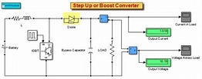
Boost converter
A boost converter (also known as a step-up converter) is one of the simplest types of switch-mode converters. As the name suggests, the converter takes an input voltage and boosts it. In other words, it’s like a step-up transformer i.e it steps up the level of DC voltage (while the transformer step-up / down the level of AC voltage) from low to high while decreasing the current from high to low while the supplied power is same.
The boost converter is very simple and requires very few components, this is because they were originally designed and developed in the 1960s to power electronics on aircraft. The biggest advantage of a boost converter is it offers very high efficiency. Some of the boost converters can go up to 99% efficiency. That means of the input voltage only 1% of the power is wasted.

Slide 9
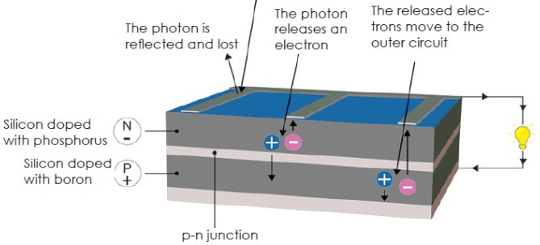
PV Array/Solar cell
Solar cells convert the energy in sunlight to electrical energy. Solar cells contain a material such as silicon that absorbs light energy. The energy knocks electrons loose so they can flow freely and produce a difference in electric potential energy, or voltage.
The flow of electrons or negative charge creates electric current. Solar cells have positive and negative contacts, like the terminals in a Battery. If the contacts are connected with a conductive wire, current flows from the negative to positive contact. The Figure below shows how a PV cell works to generate electricity.
Different Types of PV Cells
1. Crystalline Silicon PV Cells (Monocrystalline)
2. Thin-film or Polycrystalline PV Cells
Solar Cell

Slide 10
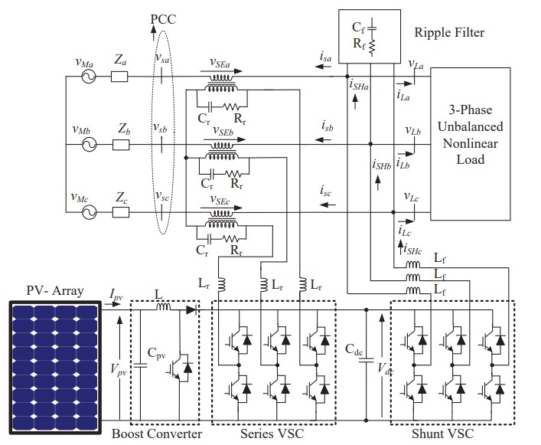
Circuit Diagram

Slide 11
Circuit Description
The topology is a three-phase double-stage configuration in which a boost DC-DC converter interfaces the PV array to the DC-link of UAPF.
The compensators are connected to the distribution system through filter inductors.
The series active filter applies voltage in series with the PCC through series transformers.
Ripple filters consisting of a series connection of resistors and capacitors, are used in both series and shunt voltage source converters (VSCs) to filter out higher-order harmonics generated due to the switching action of series and shunt active filters
The primary objective of the UAPF-PV system is to compensate for harmonics due to nonlinear load and protect sensitive loads from PCC voltage dip/rise
.Along with power quality improvement, the UAPF-PV system also performs the function of clean energy generation by supplying PV power into the distribution system.

Slide 12
Results
The performance of the three-phase double-stage UAPF-PV system is simulated in Matlab-Simulink software
The system is tested under various dynamic conditions such as load balance, irradiation variation, voltage sag/swell
SIMULATION PARAMETERS Supply System: 415 V, 50 Hz, Three Phase Supply; Load: Rectifier with R-L 12Ω, 100mH; DC-bus Voltage (Vdc) = 700 V; DC-bus Capacitor (Cdc) = 5 mF; Boost Inductor (L) = 2

Slide 13
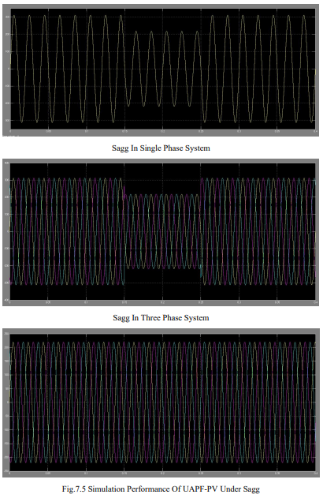

Slide 14
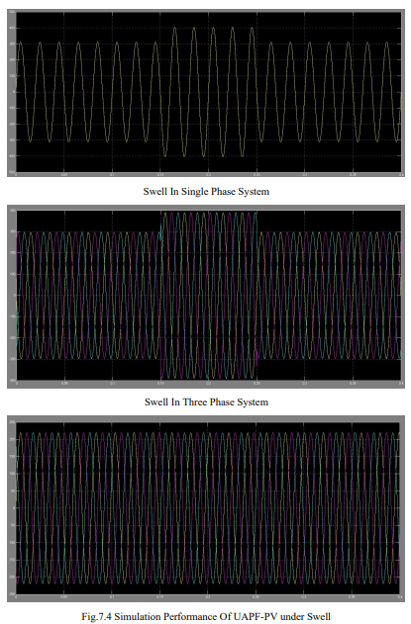

Slide 15
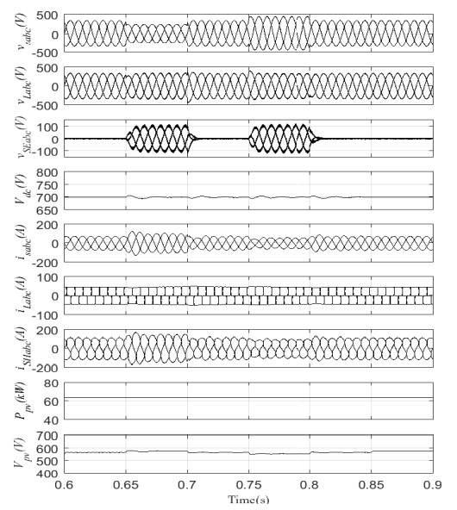
Simulated Performance of UAPF-PV System under Unbalanced load

Slide 16
References
S. J. Pinto, G. Panda, and R. Peesapati, “An implementation of hybrid control strategy for distributed generation system interface using Xilinx system generator,” IEEE Transactions on Industrial Informatics, vol. 13, no. 5, pp. 2735–2745, Oct 2017.
Sachin Devassy, Member, IEEE, and Bhim Singh, Fellow, IEEE
B. Singh, A. Chandra, K. A. Haddad, Power Quality: Problems and Mitigation Techniques. London: Wiley, 2015.
S. Singh, B. Singh, G. Bhuvaneswari, and V. Bist, “A power quality improved bridgeless converter-based computer power supply,” IEEE Transactions on Industry Applications, vol. 52, no. 5, pp. 4385–4394, Sept 2016.

Slide 17


